Slide 1
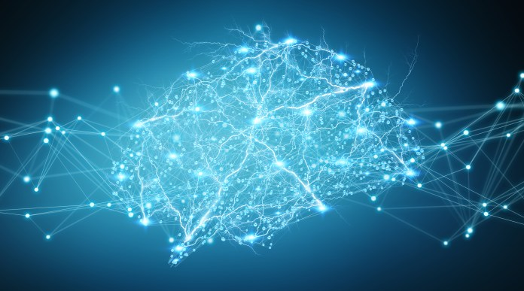
Accelerating Abnormal-Behavior Detection in Surveillance Video via Deep Neural Networks & Group Testing Methods

Slide 2
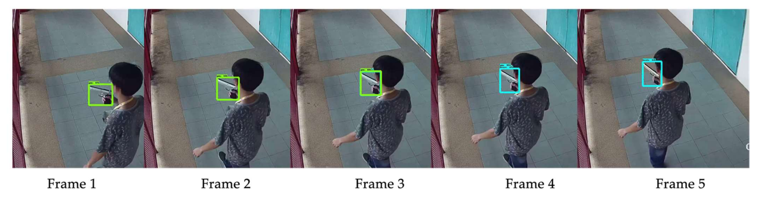
Motivation: The Firearm Detection Problem in CCTV
Challenge: Efficiently detecting abnormal behavior within vast surveillance footage.
Target: Detect and locate this in hours of footage.

Slide 3
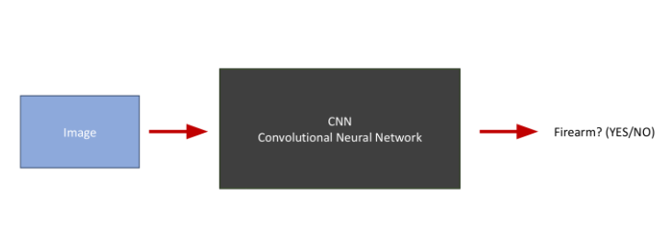
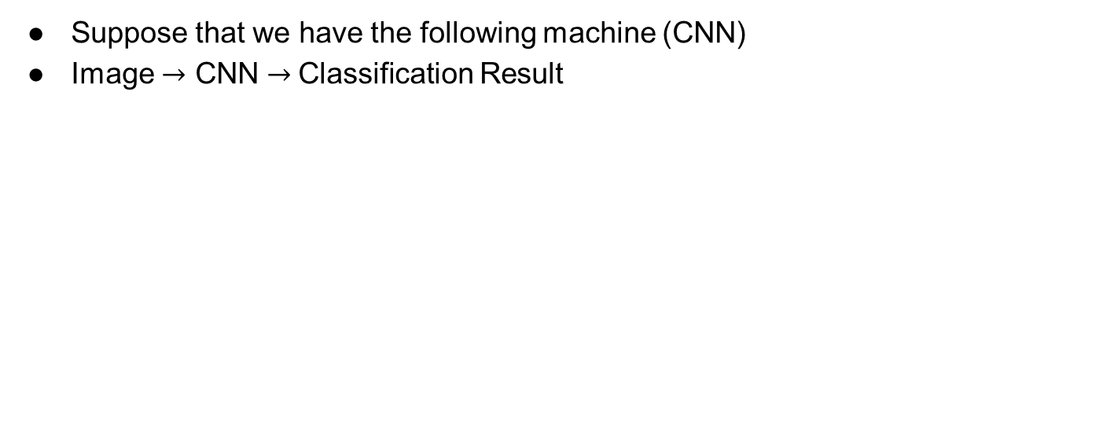
CNN: A High-level Overview
Suppose that we have the following machine (CNN)
Image $→$ CNN $→$Classification Result
Notes:
Take original slide with animation

Slide 4
Motivation
Can we exploit this machine to look for firearm in CCTV (videos)?
CNN
Convolutional Neural Network
Image
Firearm? (YES/NO)
Sure…
CCTV
Frames

Slide 5
Naive Solution
CNN
Convolutional Neural Network
CCTV
Firearm?
(YES/NO)
Convert the video to frames
Check each frame one by one

Slide 6
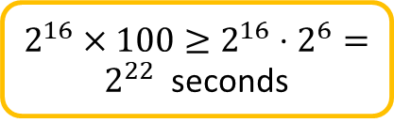
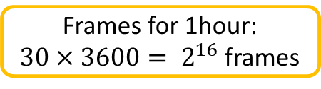
Problems with this solution
Suppose that we are asked to implement an automatic firearm detector to help police department to check CCTV’s from some street where a crime has occurred.
We want to find the exact time when some crime occurred within a range of one hour (e.g. 3:00am -4:00 am)
CNN
Convolutional Neural Network
CCTV
Firearm?
(YES/NO)
Standard CCTV frame rate is 30FPS
Inference GPU time: 100s for a single image
~85days

Slide 7
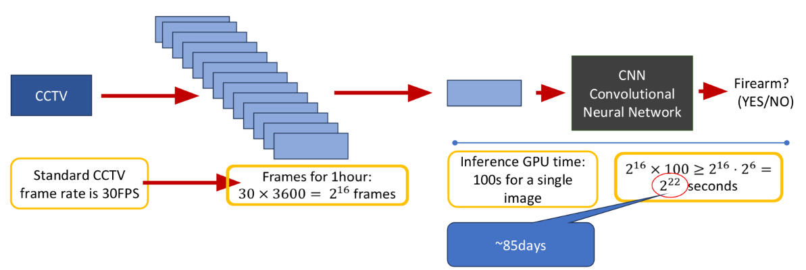
Inference Time Bottleneck
Issue: High inference time. Not suitable for real-time CCTV analysis.
Millions of frames = Significant delay.

Slide 8
Three Possible Solutions
Choose a subset of the frames
Reduce inference time
Hardware
Optimize the structure of the CNN
Group Testing (We will mainly focus on this)
Notes:
Change to original silde.. Make it visual

Slide 9
Solution #3: Group testing
Image
CNN
Convolutional Neural Network
Firearm? (YES/NO)
Due to the work of:
Weixin Liang, James Zou
Suppose that we can enhance the CNN such that:
Image
CNN
Convolutional Neural Network
Image
Yes: at least one frame includes firearm
No: Firearm clean
Image
Image
Image
Image

Slide 10
Solution #3: Group testing (cont.)
Image
CNN
Convolutional Neural Network
Image
Yes: at least one firearm frame
No: Firearm clean
Image
Image
Image
Image
How we choose the frames in each group, so we can actually determine the desired ones ????
Due to the work of: Bshouty & Haddad-Zaknoon
Do we really need to identify ALL the frames with firearm image?
Notes:
Add aws

Slide 11
Let’s take a deeper look…
Assume that we have reduced the number frames.
By choosing frames uniformly at random or ..
Making some kind of average on images (for example pixel based average)
We order the chosen frames according to their original timeline.
The blue frames are ones that capture the abnormal event.
They are consecutive, because we ordered the chosen frame according to their time.
We need to determine this time frame within the video
3:00
It is enough to find a single frame that captured the event
4:00

Slide 12
Why Group Testing
Group Testing works well for a small number of defective items; usually, the abnormal frames only account for a small portion of the whole frames.
Abnormal frames are consecutive, so it is enough to find a single frame that captured the event.
Notes:
Make icon

Slide 13
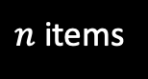
What is Group Testing?
YES (positive)
NO (negative)
A group test is a subset of elements form the pile.
A group test result is positive
if there is at least one “red” (defective) item in this subset and negative otherwise.
Target: identify the set of defective items using minimum number of group tests
Notes:
color

Slide 14
Story 1: poisoned bottle adaptive
Story 2: poisoned bottle non-adaptive
Add the slide about what is adaptive/non-adaptive
Add a slide with the question: what if d>1
Introduce the disjunct matrix
The decoding alg.
Slide on random vs. det
Give the 4 randomized models

Slide 15
What is Group Testing Problem?
•Def: Given a set S of n items, among which d are defective, the objective is to identify the defective items by performing the minimum number of tests.
•Using GT(like designing some adaptive or non-adaptive algorithms) to solving such problems
Notes:
Too wordy use original slides

Slide 16
Adaptive algorithm
•A new test is chosen according to the results of previous tests.
•This algorithm proceeds according a “binary tree like” shape. Where each node signifies a test and the leaves signify the possible outputs.
Notes:
In GT01

Slide 17
Non-Adaptive Algorithms
•Tests are chosen in advance and performed in ONE single parallel step.
•Upon getting the result vector, the algorithm decodes the outcome and decides on its output. The decoding process requires NO further testing.

Slide 18
Example problem: The poisoned bottle.
•The king and the wine riddle:
•The King of a small country invites 1000 senators to his annual party.
•Each senator brings the King a bottle of wine.
•The queen discovers that one of the senators is trying to assassinate the King by giving him a bottle of poisoned wine
•Unfortunately, they do not know which bottle of wine is poisoned, and the poison is completely indiscernible.
•The King has 10 prisoners he plans to execute. He decides to use them as taste testers to determine which bottle of wine contains the poison.

Slide 19
Adaptive algorithm for poisoned bottles.
•Define a single group test
•Perform the group test
•Upon getting the result, decided on your next test

Slide 20
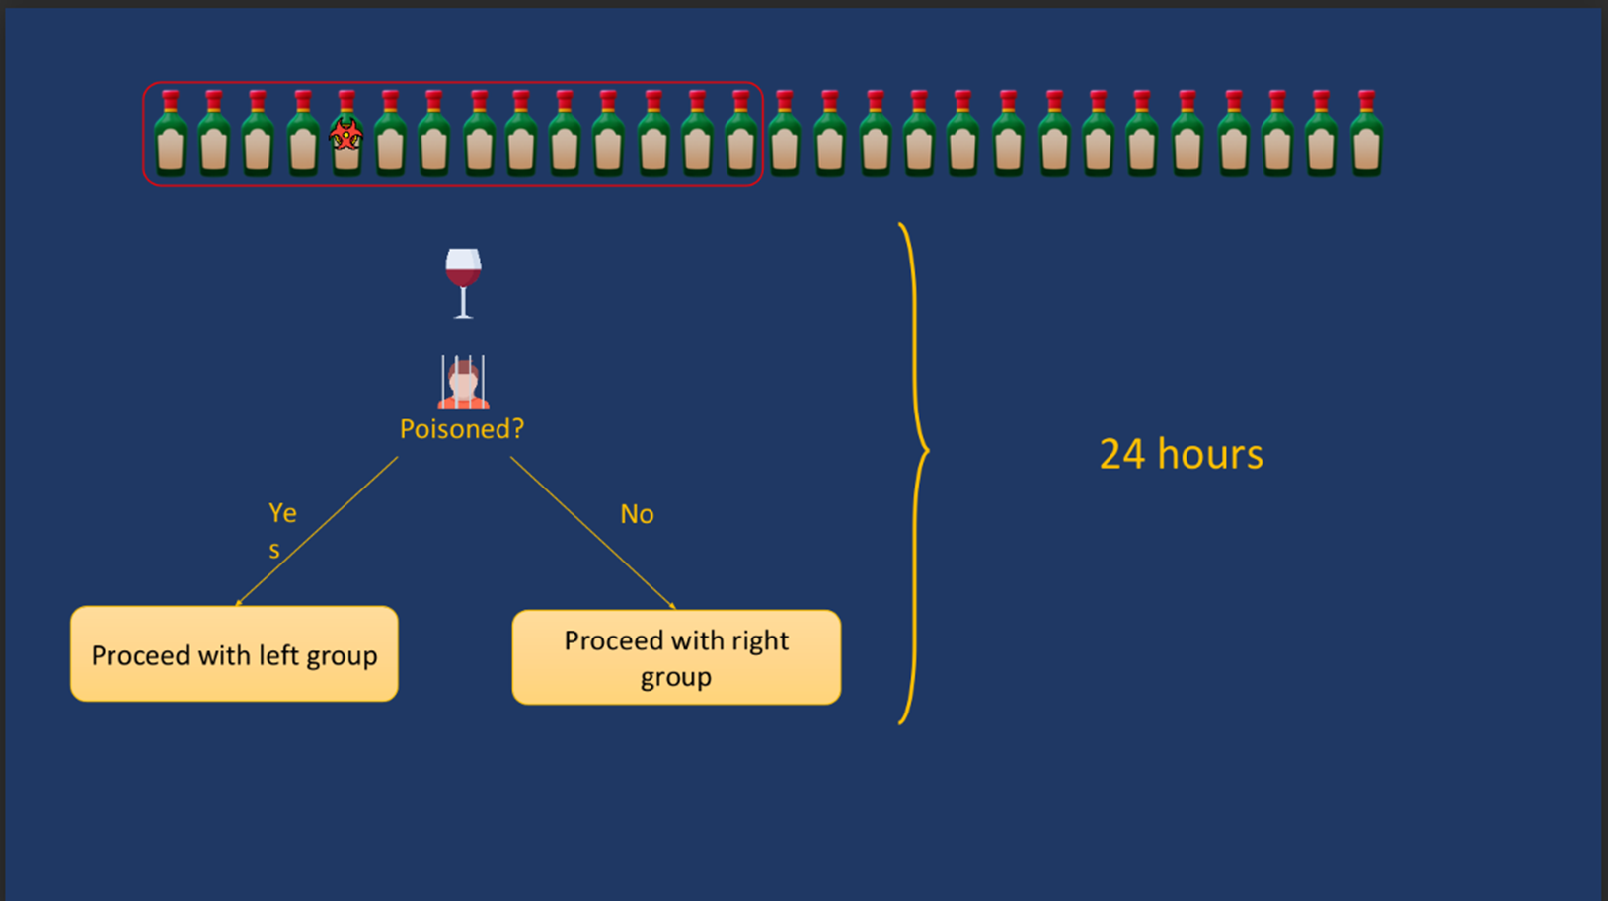

Slide 21
Non-Adaptive algorithm for poisoned bottles.
•Define all group tests in advance
•Perform all the group tests in parallel
•Upon getting the results, decode the result without any further testing

Slide 22
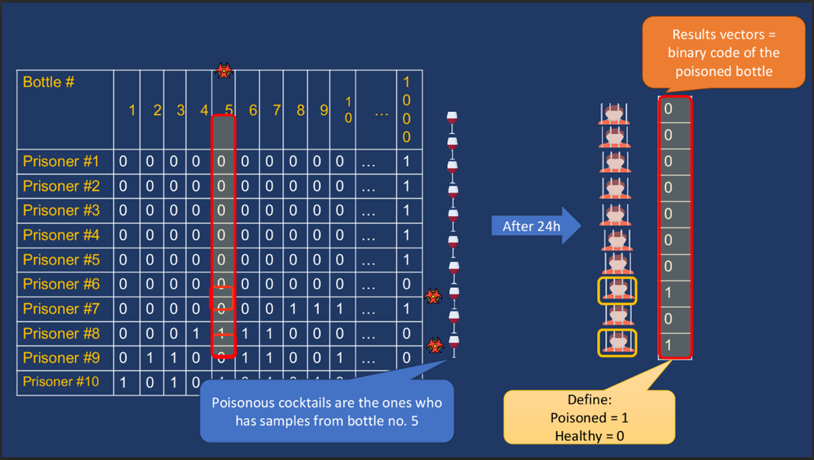

Slide 23
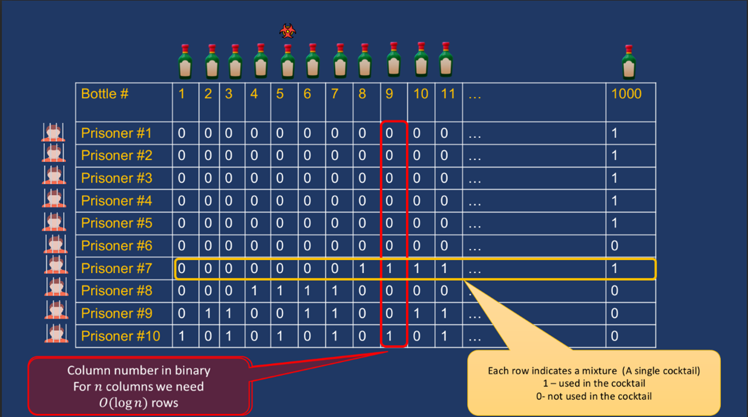

Slide 24
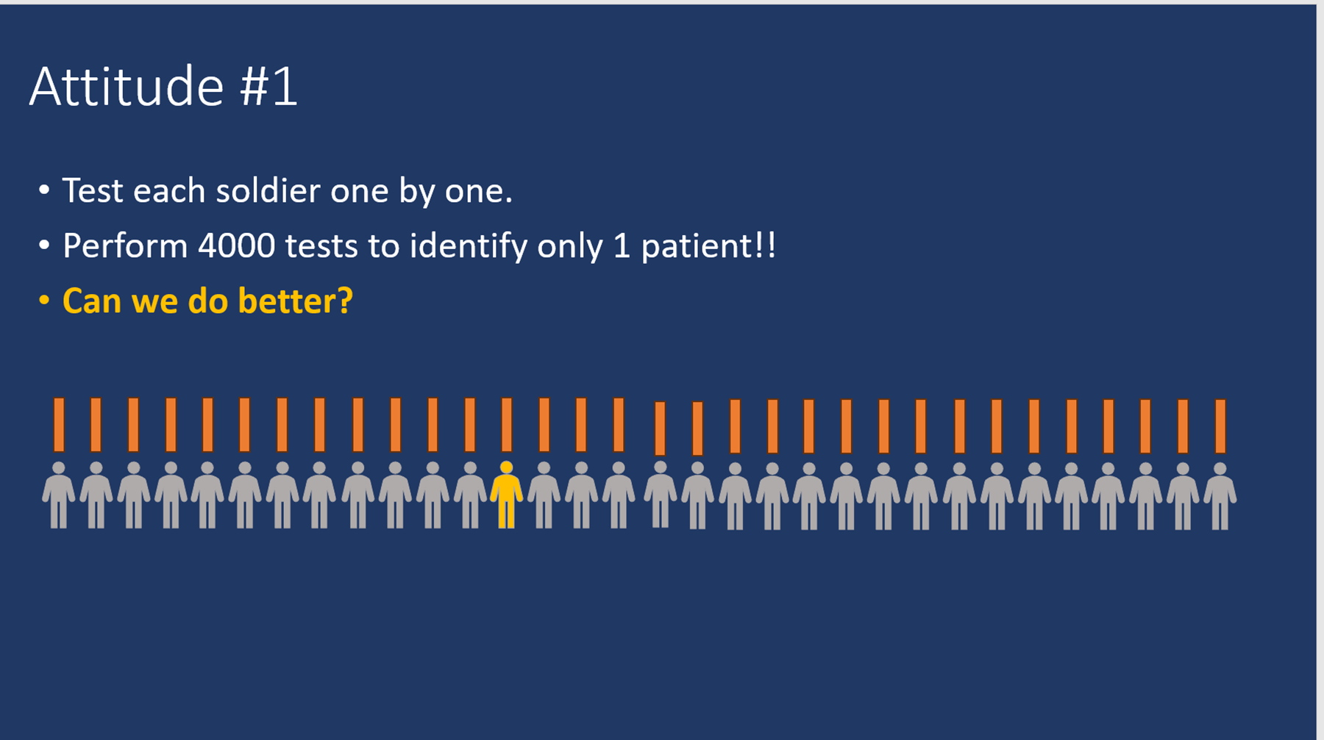

Slide 25
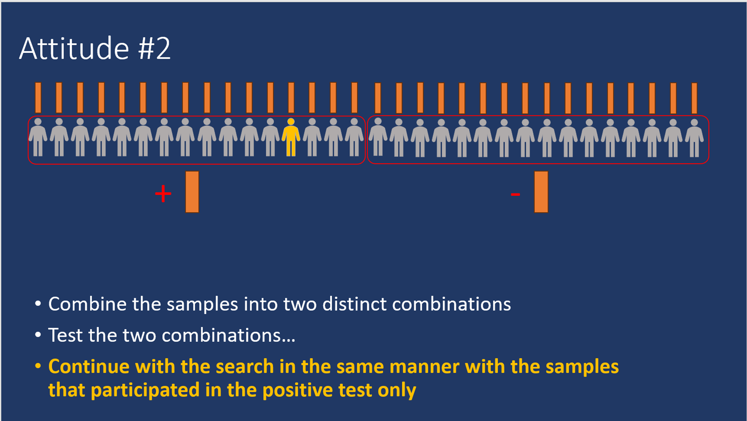

Slide 26
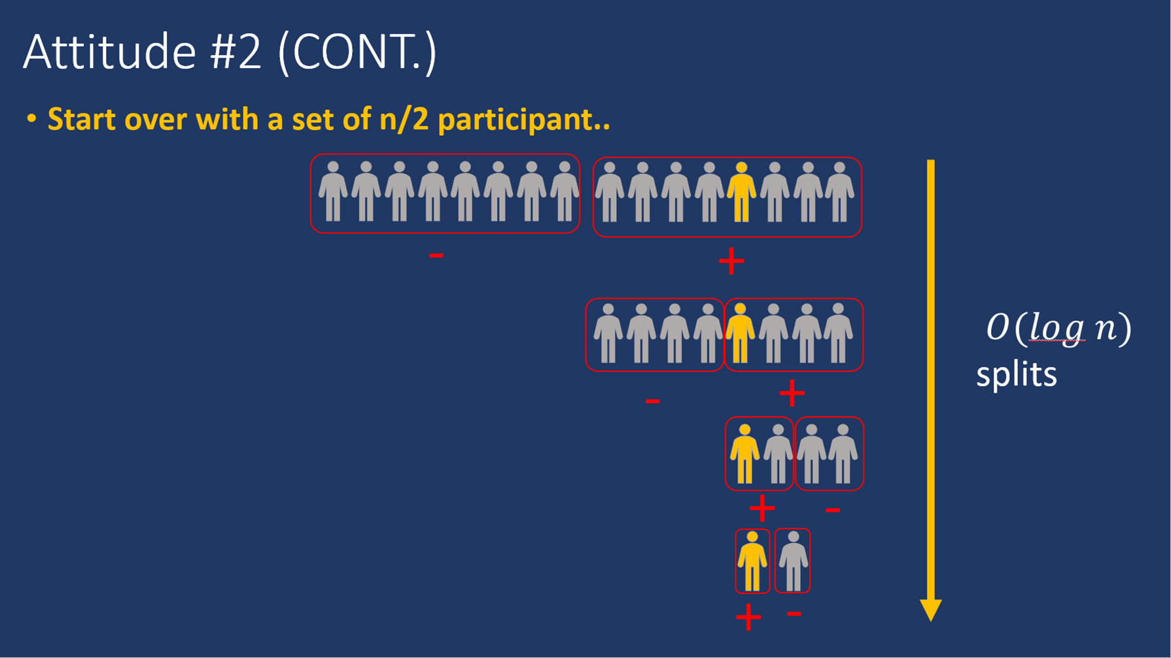

Slide 27
Group testing 2 – non-adaptive algorithms
•We are trying to optimize the number of tests we do
•Tests = Cocktails in the poisoned bottle problem
•Test = running an image via the CNN in the context of image classification.
•Why we are interested in randomized non-adaptive algorithms
•Non-adaptive: tests take time and it will be better to do them in parallel
•Randomized: the bounds on the number of tests for deterministic vs. randomized

Slide 28
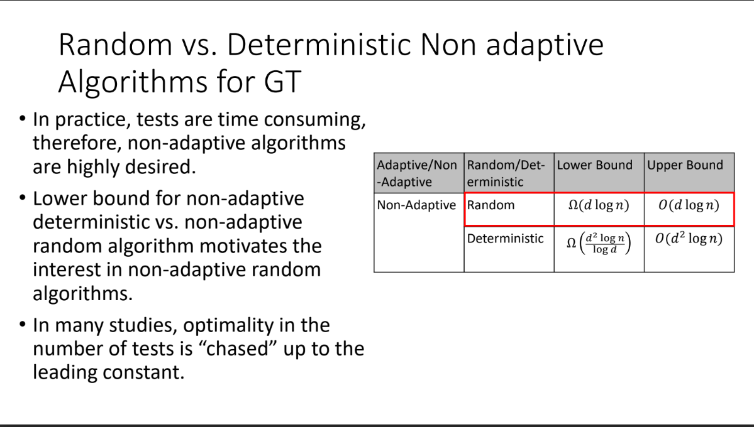

Slide 29
test matrix (an example for matrix from poisoned bottle problem)

Slide 30
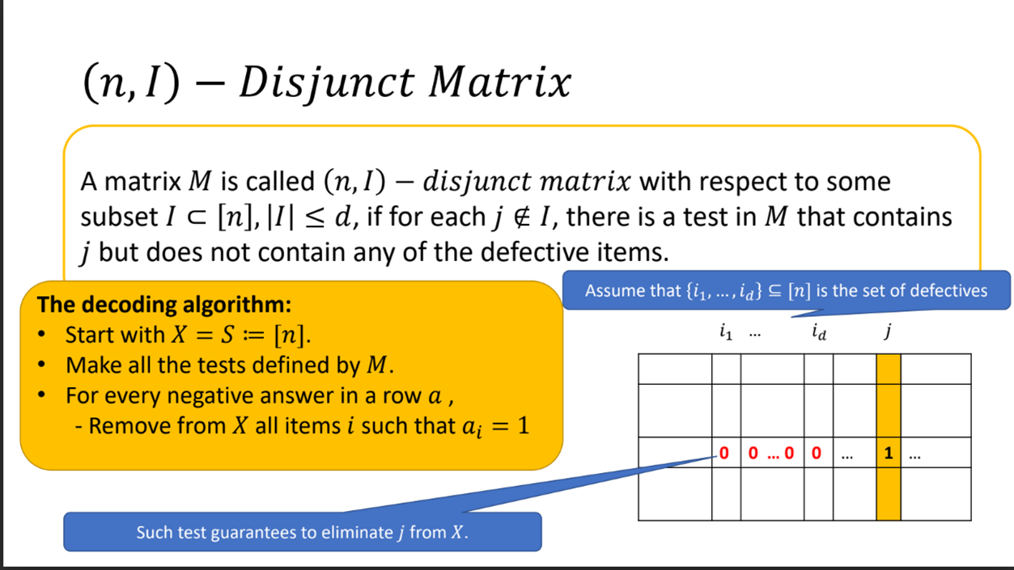

Slide 31
Recall the Function of Neural Network (NN)
Image
CNN
Convolutional Neural Network
Image
Yes: at least one frame includes firearm
No: Firearm clean
Image
Image
Image
Image

Slide 32
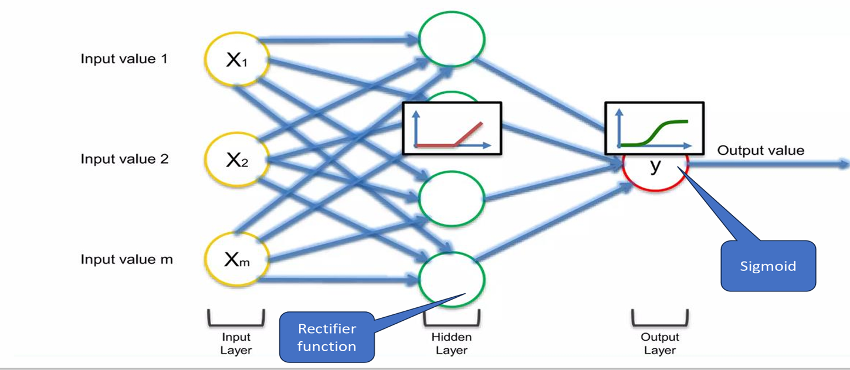
The Structure of Convolution Neural Network(CNN)

Slide 33
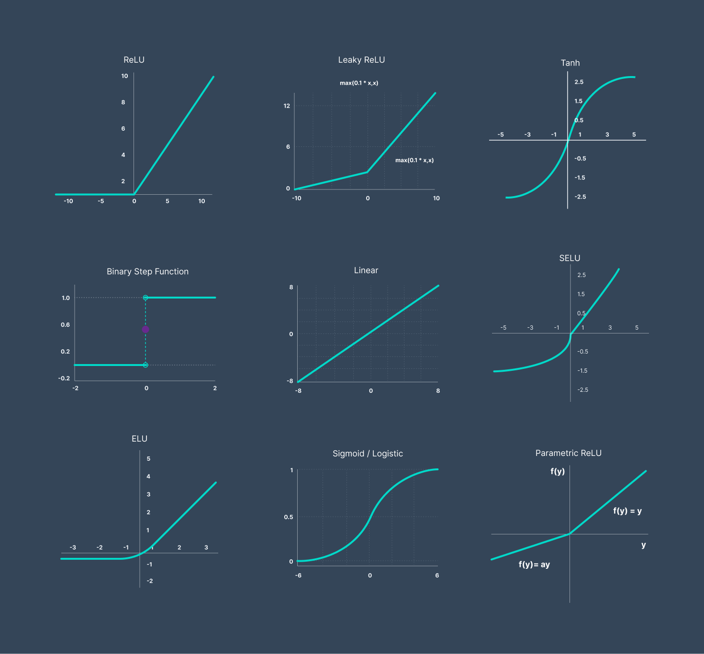
Activation Function:
ReLU and its family members are popular stars in NN
Sigmoid is widely used for distribution of probabilities

Slide 34
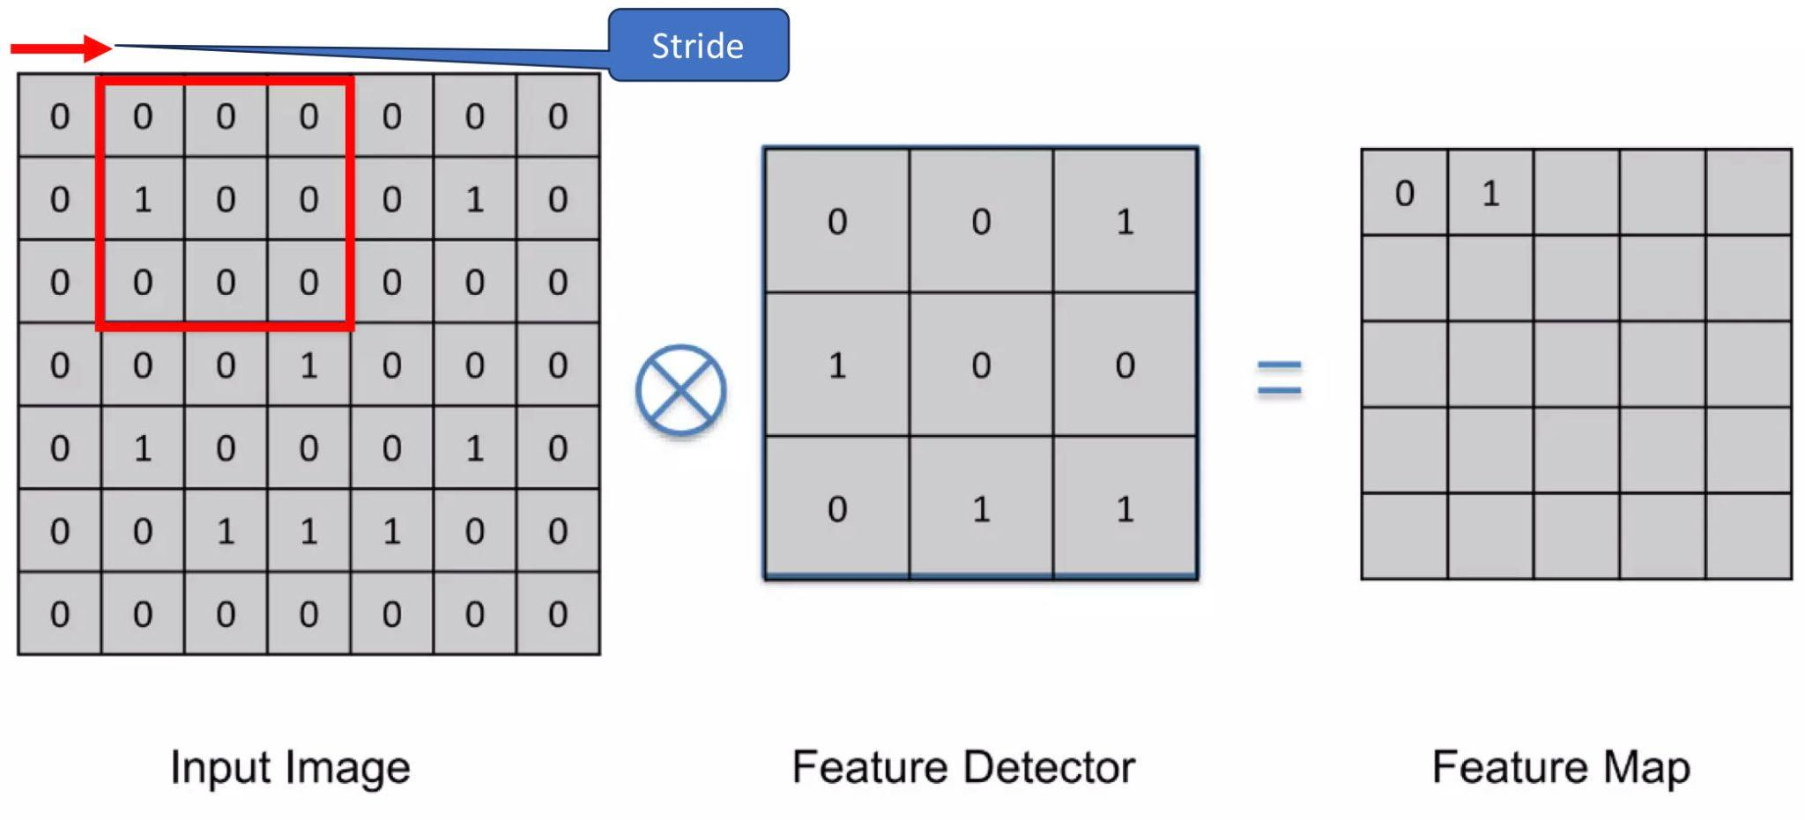
Convolution:
Notes:
additional layers, function

Slide 35
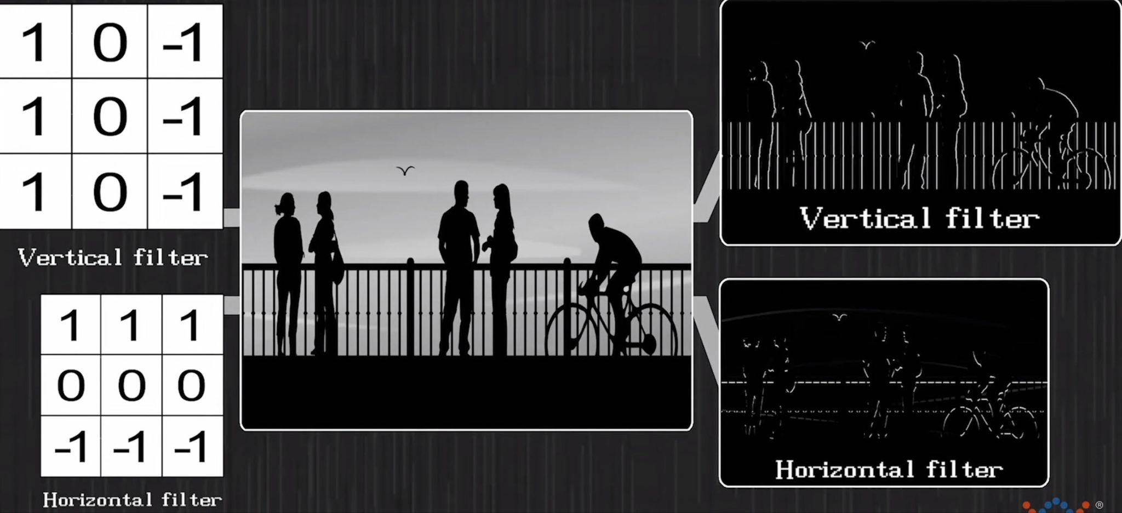
Example:

Slide 36
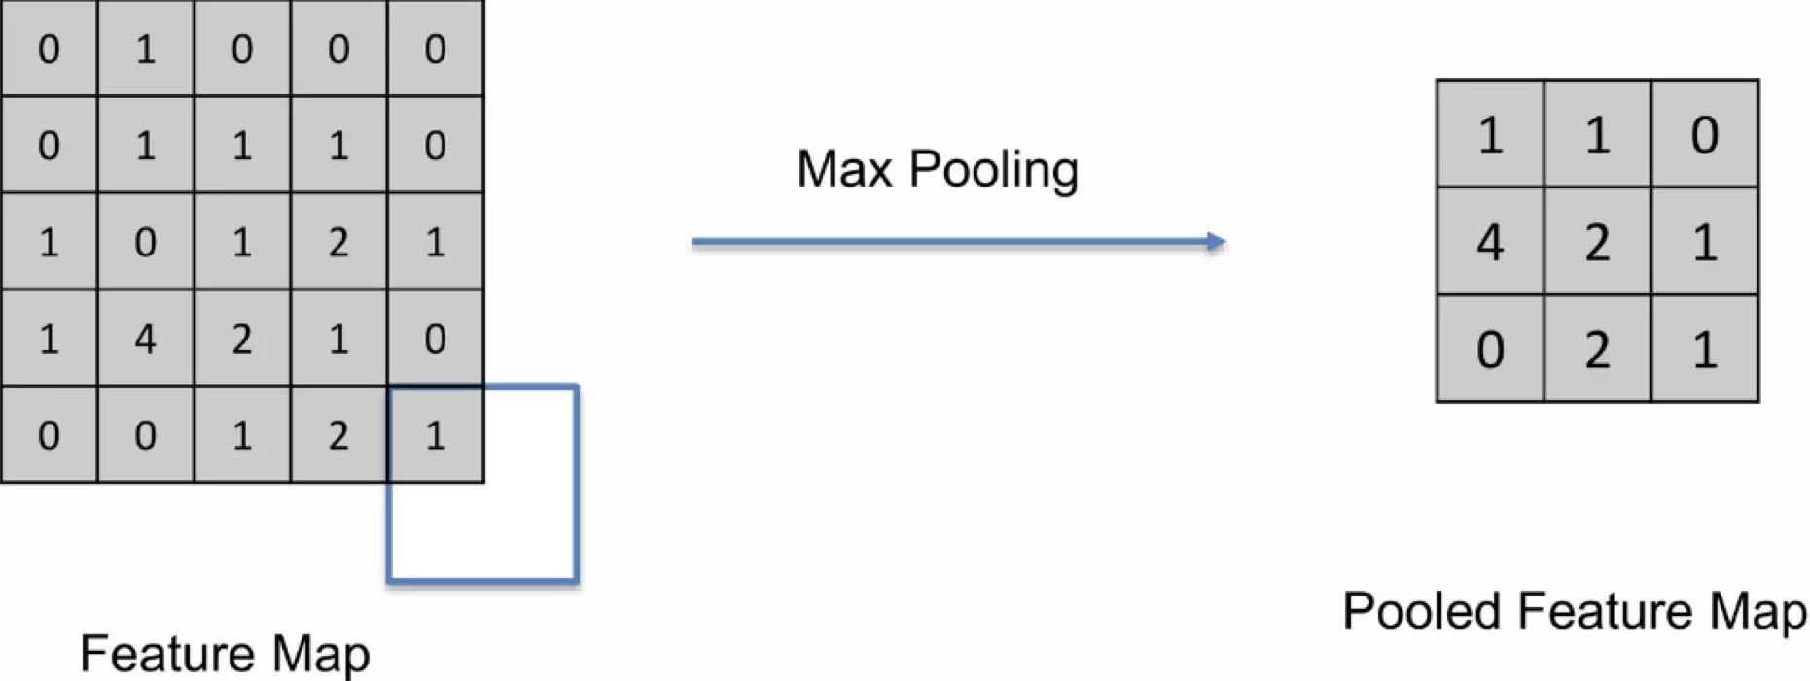
Pooling:

Slide 37
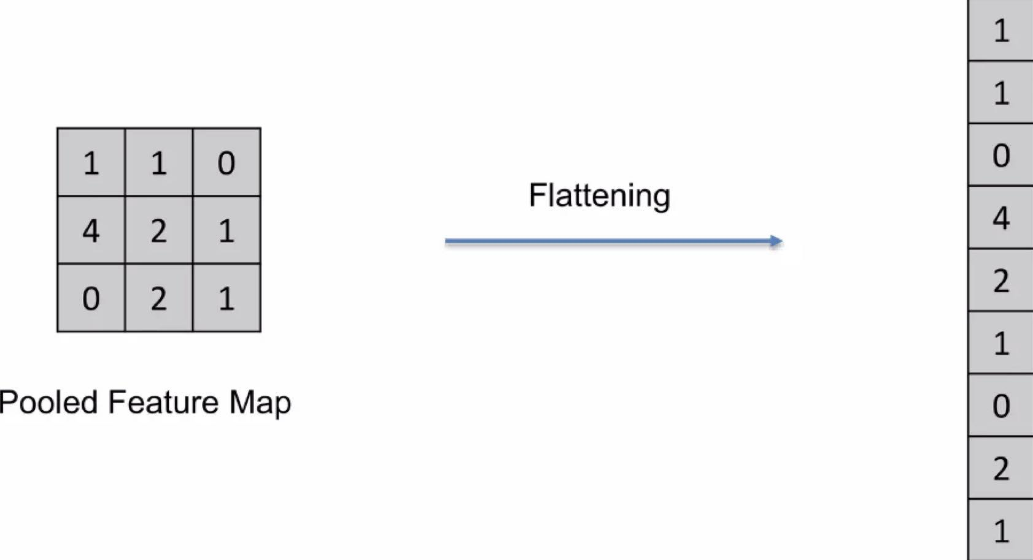
Flatening:

Slide 38
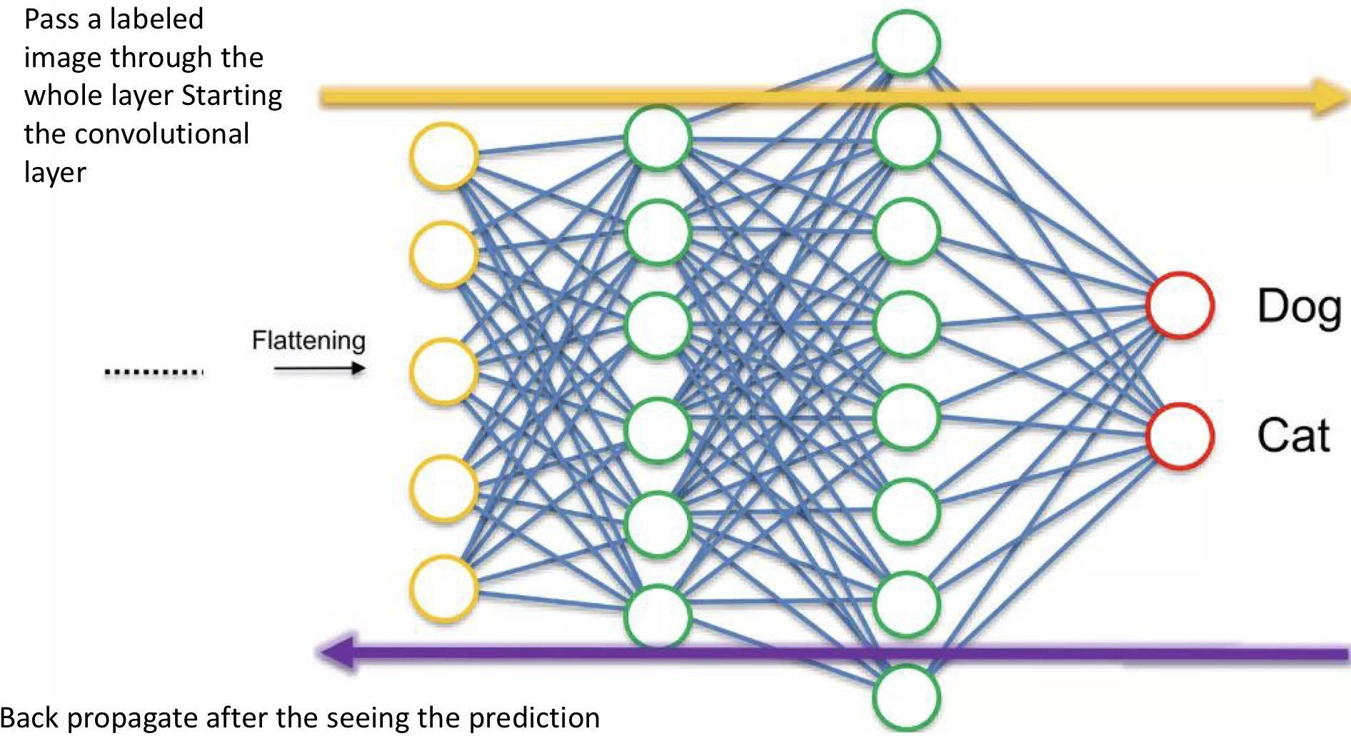
Fully connected NN:

Slide 39

Baseline : Individual Test
Test each image individually and run a forward pass of CNN

Slide 40
Applying Group Test to CNN
How we group the Images and input the CNN?
We build on the Neural Network developed by Weixin Liang and James Zou that supports group testing for images.

Slide 41
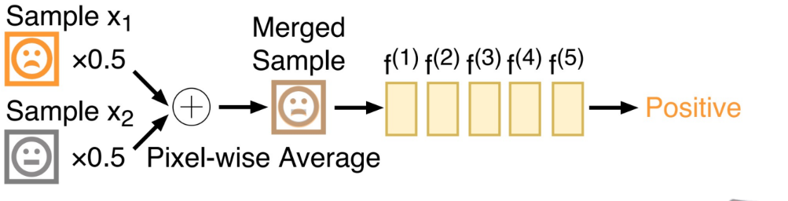
Design1: Pixel Merge (Mixup)

Slide 42
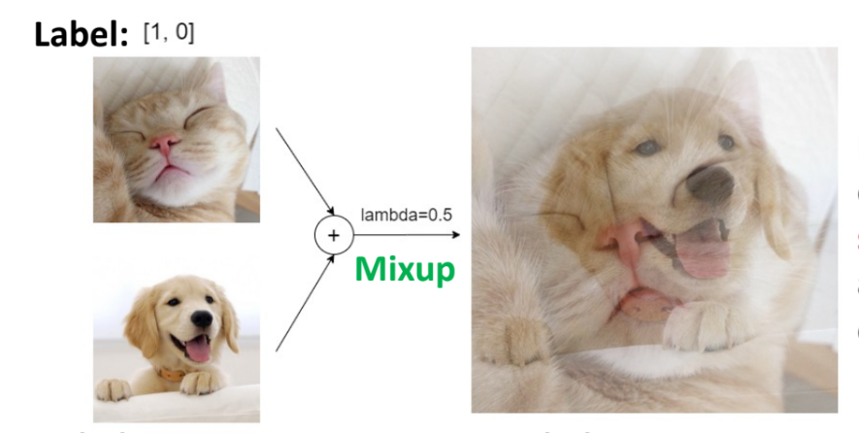
GT and CNN marriage
Take the average value for each pixel in both cat and dog images before input images
Notes:
Three designs, copy

Slide 43
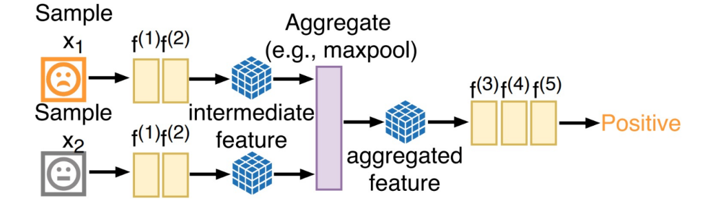
Design2: Feature Merge
Run each sample through first few layers and try to merge the features into one. Design1 is the special case of 2

Slide 44
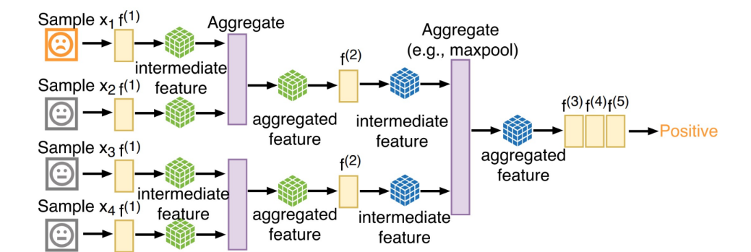
Design3: Tree Merge (Powerful)
Merge samples hierarchically and recursively at different levels of CNN. The whole procedure of this looks a binary tree, the output is the root. Design 2 is also the special case of 3.

Slide 45
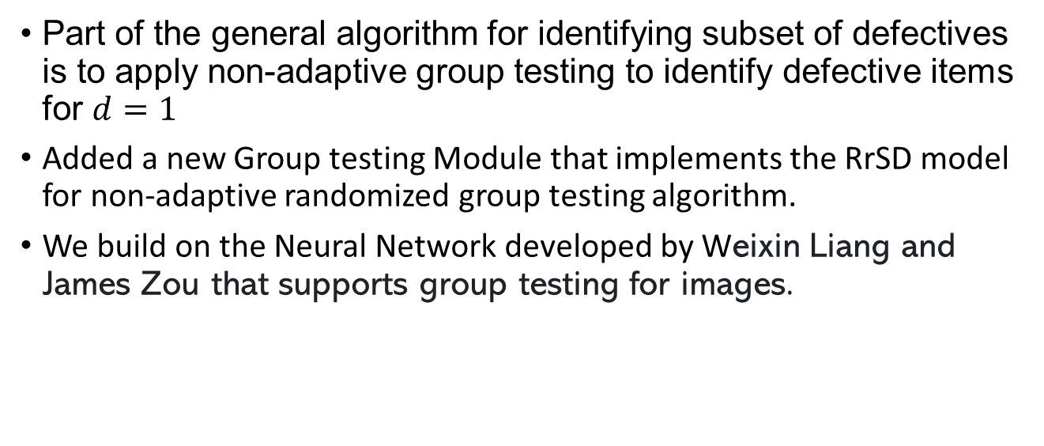
Our Work
Part of the general algorithm for identifying subset of defectives is to apply non-adaptive group testing to identify defective items for $d=1$
Added a new Group testing Module that implements the RrSD model for non-adaptive randomized group testing algorithm.
We build on the Neural Network developed by Weixin Liang and James Zou that supports group testing for images.

Slide 46
Methods
Programming language: python
Version control system Git and GitHub
Training Server:
96 Intel(R) Xeon(R) Gold 6336Y CPU @ 2.40GHz 503GB RAM 8 x NVIDIA A40 – 49GB
Traning Set: Imagenet

Slide 47
Methods : ImageNet dataset
•ImageNet is a dataset of over 14 million hand-annotated images.
•The dataset is organized according to the WordNet hierarchy, which groups similar concepts together. ImageNet has over 20,000 categories, and for each category, there are typically several hundred images.
•Key contributors to the project include:
•Dr. Fei-Fei Li: The principal investigator and driving force behind ImageNet.
•Jia Deng, Wei Dong, Li-Jia Li, Kai Li, and Li Fei-Fei: Co-authors of the 2009 paper "ImageNet: A Large-Scale Hierarchical Image Database," which introduced ImageNet to the computer vision community.
Notes:
wordy

Slide 48
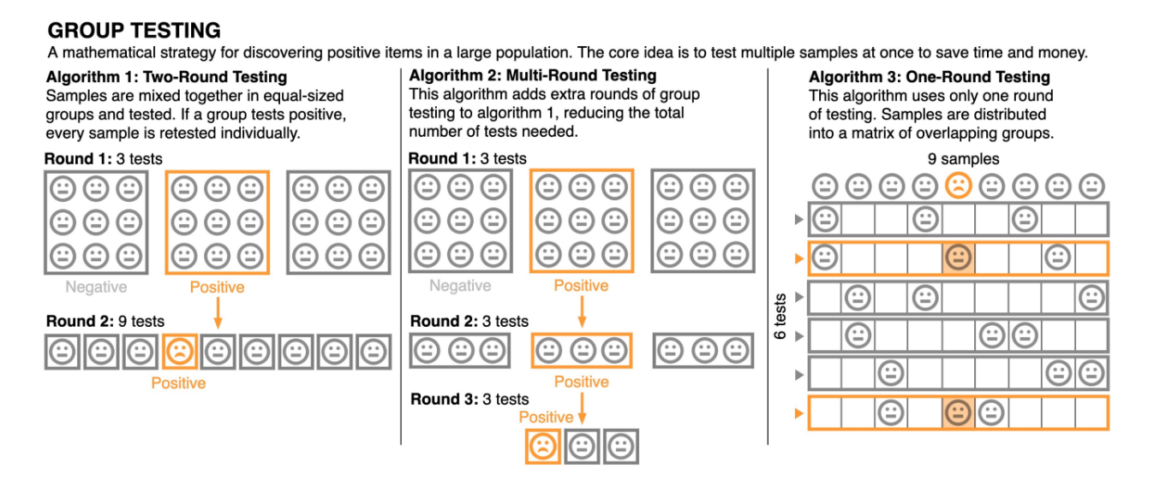

Slide 49
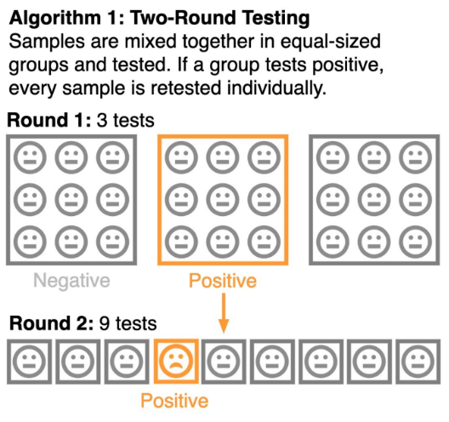
GT in the original work: 2-round group testing
Round 1:
Divide the images into distinct groups and tests
Round 2:
For each positive group, test each image individually.

Slide 50
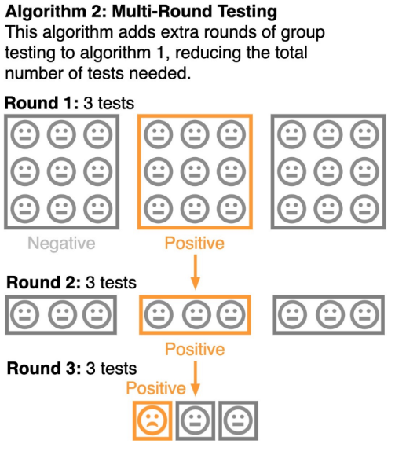
GT in the original work: Multi-round group testing
Round 1:
Divide the images into distinct groups and tests
Round 2:
Split the positive group into smaller distinct groups and test.
Round 3:
Test images in positive groups one by one.

Slide 51
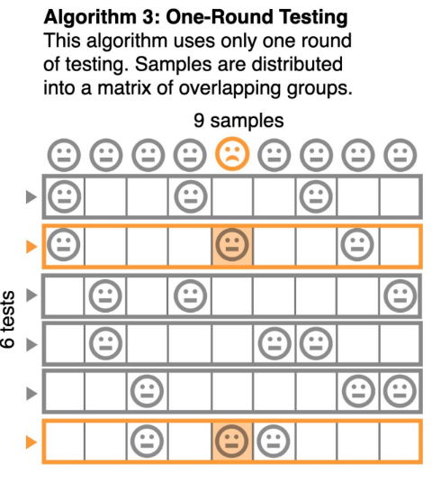
GT in the original work: Non-adaptive GT (deterministic)
Divide the images into distinct groups of a fixed TWICE
Each item will be included in TWO groups
An item is positive if both groups it participated in are positive.

Slide 52
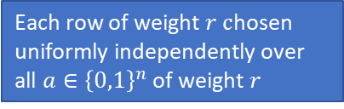
Implementing RrSD model: Creating the matrix
RrSD
Implemented the method:
GroupTestingRrSD_ValLoader
. .
Each row of weight $r c$hosen uniformly independently over all $a∈{\left\{0,1\right\}}^{n}$ of weight $r$

Slide 53
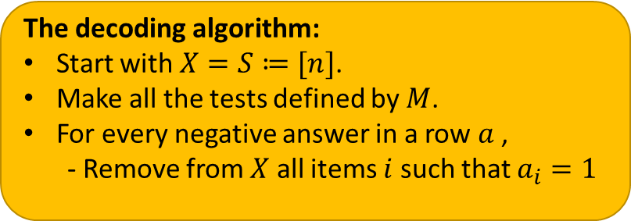
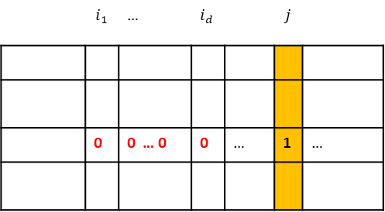
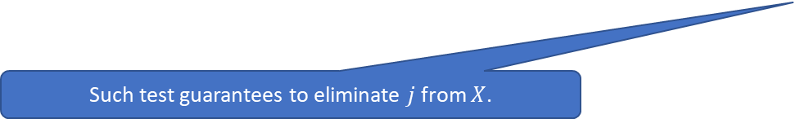
Implementing RrSD model: Creating the wrapper function
Implemented a wrapper function:
Responsible for processing the results and decoding the fire-arm images.
Measures the performance of the decoding compared to single image by image testing
 | $$i_{1}$$ | … | $$i_{d}$$ |  | $$j$$
 | 0 | 0 … 0 | 0 | … | 1 | …
The decoding algorithm:
Start with $X=S≔[n]$.
Make all the tests defined by $M$.
For every negative answer in a row $a$ ,
- Remove from $X$ all items $i$ such that $a_{i}=1$
Such test guarantees to eliminate $j$ from $X$.

Slide 54
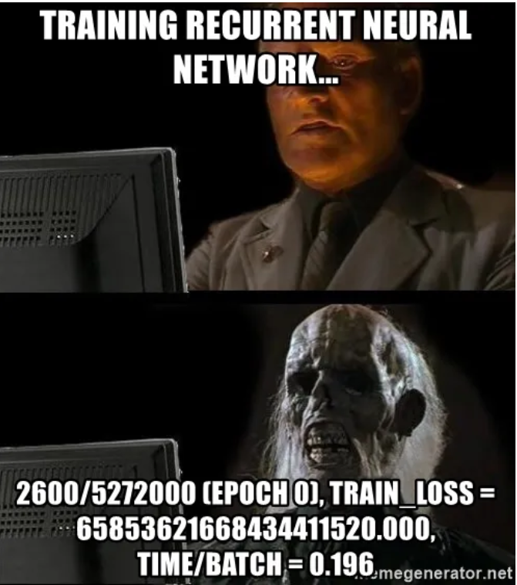
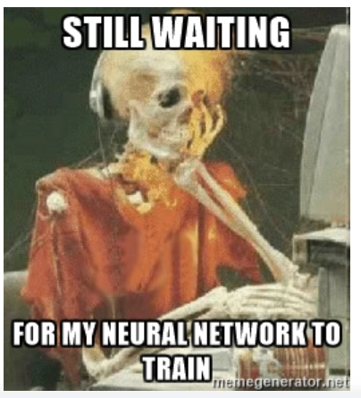
Real results on the trained model

Slide 55
Building Simulator
Why we need that:
Training the model takes much time
Our main goal here is to test our group testing algorithm
What we do here:
Randomize the expected output of the model to assume that we have a model that has an accuracy of 0.9

Slide 56
Building Simulator

Slide 57
Why We Need This
Model training is time-consuming.
Our primary objective is to evaluate the performance of our group testing algorithm.

Slide 58
What We Do
Simulate the model's expected output to approximate a model with a 90% accuracy rate.

Slide 59
How the Simulator Works
Target
Simulator
Accuracy
Images
Group Test
Output

Slide 60
Further direction to investigate
Further investigate the performance of group testing algorithms on these settings.
Can we adopt the trained CNNs to work with any size of group?
To make real-world identification of firearm, the CNN should be trained on images from surveillance cameras rather than high resolution dataset like ImageNet.

Slide 61
Photos and thanks

